Slide 1
COMP 3500 Introduction to Operating Systems Project 3 and 4 – Synchronization Overview
Dr. Xiao Qin
Auburn University http://www.eng.auburn.edu/~xqin
xqin@auburn.edu
Notes:
Fall’20
Lec13 Slides 19-27: 40 Min
Lec14 Slides 1-9: 10Min
Spring:
Lec04c: Lec04b-Project 3 Overview Slides.
Fall’16: 30 Minutes all 13 slides 12a-Semaphore
20 Minutes: 14-Project 3 Overview Slides: 11

Slide 2
Project Objectives
Project 3: To implement the lock mechanism
Project 3: To implement condition variables
Project 4: To solve a synchronization problem using different mechanisms
Projects 3/4: To improve your source code reading skills
Projects 3/4: To strengthen your debugging skill
Four weeks to achieve the above objectives!

Slide 3
Three Tasks
Task 1 (Project 3): Code-Reading Assignment
Task 2 (Projects 3 and 4): Programming Assignment
Task 3 (Project 4): Written Assignment
Notes:
Task 1: Code-Reading Assignment (15%)
Individual; Soft Deadline: 2/6
Task 2: Programming Assignment (70%)
Collaboration; Soft Deadline: 2/24
Task 3: Written Assignment (15%)
Discussion; Deadline: 2/26

Slide 4
Task 1 (Project 3): Code-Reading Assignment
Time Allocation: < 2 hours
Five Thread Questions (30-40 min)
Three Scheduler Questions (30-40 min)
Two Synchronization Questions (<1 hour)
Use the grep command:
%grep -r “hardclock” .

Slide 5
Task 2: Programming Assignment
Subtask 1 (Project 3): Implementing Locks
Subtask 2 (Project 3): Implementing Condition Variables (cv)
Subtask 3 (Project 4): A semaphore-based solution in catsem.c:
Subtask 4 (Project 4): A “CV + locks” based solution in catlock.c

Slide 6
Task 3 (Project 4): Written Assignment
You will have to offer one of the two solutions to the Synchronization Problem: Cats and Mice
(1) Explain how each of your solutions avoid starvation.
(2) Can you derive any principles about the use of these different synchronization primitives (semaphores vs. Condition Variables)?

Slide 7
Tip 1: the kmalloc and kfree functions
int* int_ptr;
char* string_ptr;
int_ptr = kmalloc(sizeof(int));
*int_ptr = 3;
string_ptr = kmalloc(10);
strcpy(str, “hello");
printf(“string = %s\n", str);
kfree(int_ptr);
Reference: https://www.tutorialspoint.com/c_standard_library/c_function_malloc.htm
Notes:
Reference: C library function - malloc() - Tutorialspoint

Slide 8
Tip 2: How to turn interrupts off?
int spl = splhigh();
/*
* Here is a section that must be
* atomically executed
*/
...
splx(spl);
Notes:
Teach students how to take notes.

Slide 9
Semaphore in OS/161 What is the difference?
What we have learned:
typedef struct {
int value; struct process *L; } semaphore;
The semaphore in OS/161:
struct semaphore {
char *name;
volatile int count;
};
Notes:
Teach students how to take notes.

Slide 10
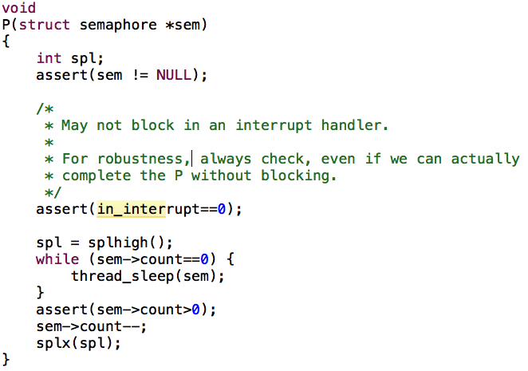
Implement P() using Semaphore in OS/161
Notes:
Teach students how to take notes.

Slide 11
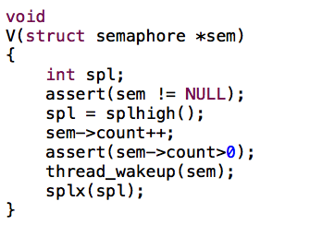
Implement V() using Semaphore in OS/161
Notes:
Teach students how to take notes.

Slide 12
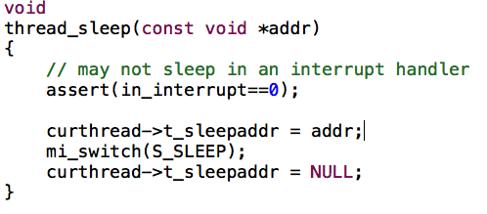
How to P() and V() collaborate through thread_sleep() and thread_wakeup()? See also Question (9) in Section 4.3
Notes:
Teach students how to take notes.

Slide 13
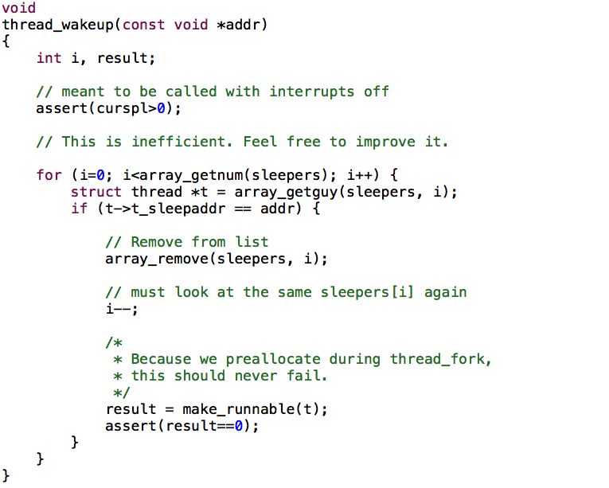
Notes:
Teach students how to take notes.

Slide 14
Locks and Condition Variables (CV) in OS/161
No monitor in OS161
We will use condition variables
We make condition variables independent (i.e., not associated with a monitor)
We will associate CV with a lock (mutex)
Threads must first acquire the lock (mutex)
CV::Wait releases the lock before blocking, acquires it after waking up

Slide 15
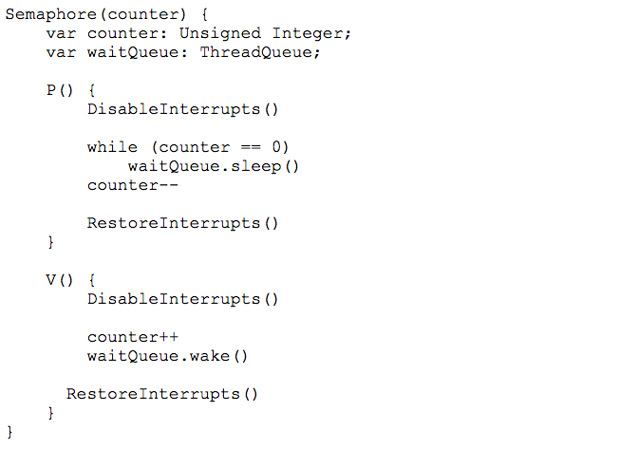
Algorithm 1: Semaphore

Slide 16
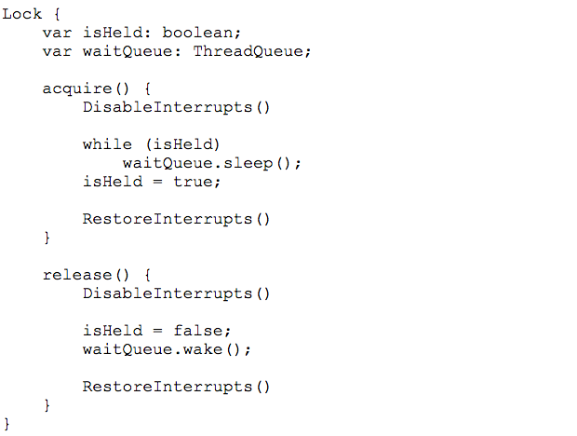
Algorithm 2: Lock

Slide 17
POSIX Mutex-related Functions
int pthread_mutex_init(pthread_mutex_t *restrict mutex, const pthread_mutexattr_t *restrict attr);
int pthread_mutex_destroy(pthread_mutex_t *mutex);
int pthread_mutex_lock(pthread_mutex_t *mutex);
int pthread_mutex_trylock(pthread_mutex_t *mutex);
int pthread_mutex_unlock(pthread_mutex_t *mutex);

Slide 18
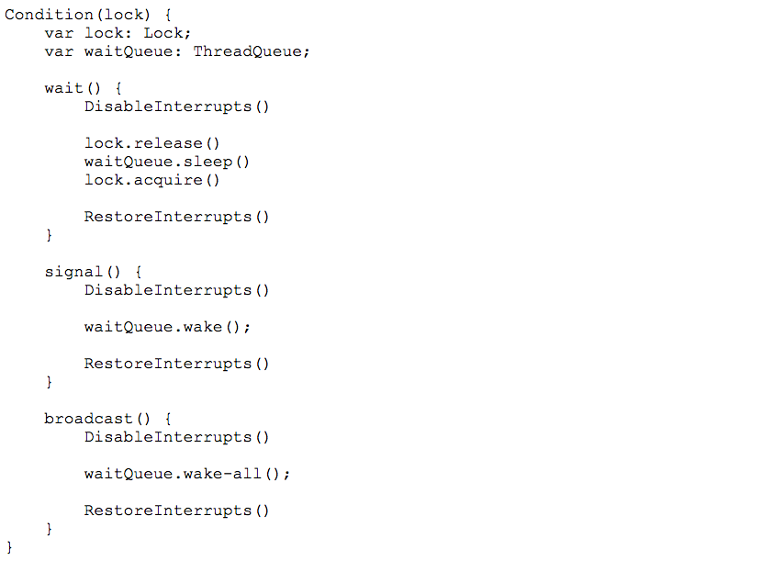
Condition Variable or CV
Notes:
A condition variable is an object used in combination with its associated lock to allow a thread to wait for some condition while it is inside a critical section. Only a thread holding the associated lock is allowed to use a condition variable associated with that lock. A condition variable has only one associated lock, but multiple condition variables may be associated with a single lock.

Slide 19
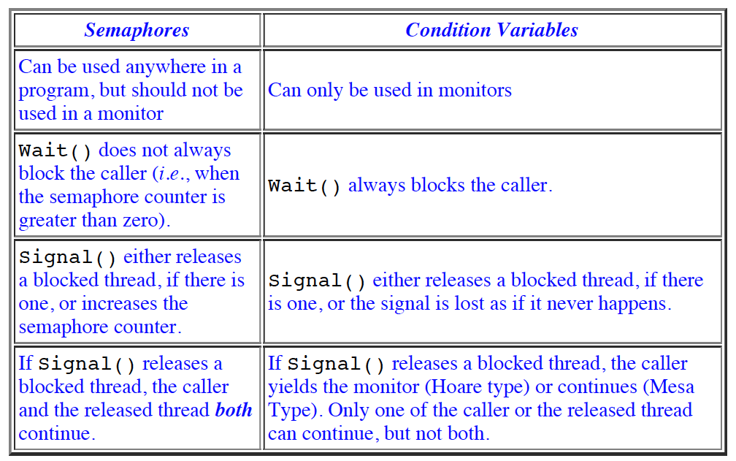
Semaphore vs. Condition Variable
Notes:
Reference:
http://www.cs.mtu.edu/~shene/NSF-3/e-Book/MONITOR/sema-vs-monitor.html
Because the wait and signal operations on semaphores and on condition variables are similar, to help you distinguish their differences and use them correctly, the following is a brief comparison.

Slide 20
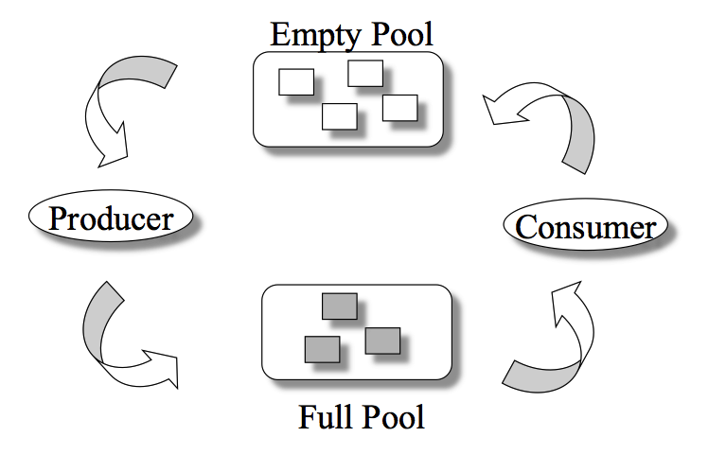
Producer/Consumer Problem
General Statement:
one or more producers are generating data and placing these in a buffer
a single consumer is taking items out of the buffer one at a time
only one producer or consumer may access the buffer at any one time
The Problem:
ensure that the producer can’t add data into full buffer and consumer can’t remove data from an empty buffer
Notes:
We now examine one of the most common problems faced in concurrent processing: the producer/consumer problem. The general statement is this: There are one or more producers generating some type of data (records, characters) and placing these in a buffer. There is a single consumer that is taking items out of the buffer one at a time. The system is to be constrained to prevent the overlap of buffer operations. That is, only one agent (producer or consumer) may access the buffer at any one time. The problem is to make sure that the producer won’t try to add data into the buffer if it’s full and that the consumer won’t try to remove data from an empty buffer. We will look at a number of solutions to this problem to illustrate both the power and the pitfalls of semaphores.

Slide 21
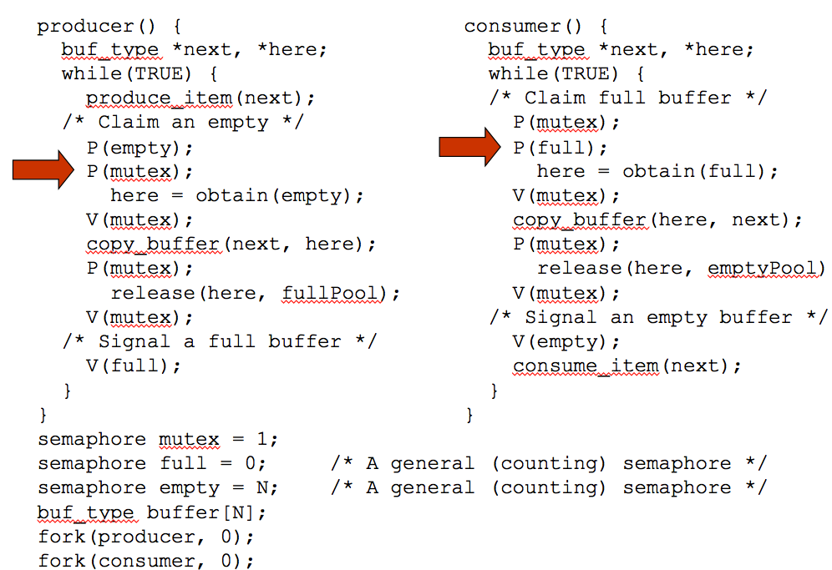
Figure 5.9
An Incorrect
Solution
to the
Infinite-Buffer
Producer/Consumer
Problem Using
Binary Semaphores
Notes:
Let us try to implement this system using binary semaphores. Figure 5.9 is a first attempt. Rather than deal with the indices in and out , we can simply keep track of the number of items in the buffer, using the integer variable n (= in – out ). The semaphore s is used to enforce mutual exclusion; the semaphore delay is used to force the consumer to semWait if the buffer is empty.
This solution seems rather straightforward. The producer is free to add to the buffer at any time. It performs semWaitB(s) before appending and semSignalB(s) afterward to prevent the consumer or any other producer from accessing the buffer during the append operation. Also, while in the critical section, the producer increments the value of n . If n = 1, then the buffer was empty just prior to this append, so the producer performs semSignalB(delay) to alert the consumer of this fact. The consumer begins by waiting for the first item to be produced,
using semWaitB(delay) . It then takes an item and decrements n in its critical section. If the producer is able to stay ahead of the consumer (a common situation), then the consumer will rarely block on the semaphore delay because n will usually be positive. Hence both producer and consumer run smoothly.
There is, however, a flaw in this program. When the consumer has exhausted the buffer, it needs to reset the delay semaphore so that it will be forced to wait until the producer has placed more items in the buffer. This is the purpose of the statement: if n == 0 semWaitB(delay) .

